Slide 1
CS563:NLP
Title: Dialogue Summarization on DailyDialog Dataset
Rizvi Chintada 2101CS20
Kasula Sravanthi 2101CS35
Varsha Kotakonda 2101CS81

Slide 2
Project objectives
Summarize conversations
Measure and minimize information loss
Generate context-aware responses based on summarized content.

Slide 3
Dataset Preprocessing:
Loaded and preprocessed the DailyDialog dataset, concatenating dialogue utterances into one string.
Model Initialization:
Loaded the pre-trained DialoGPT-Medium model and tokenizer using Hugging Face.
Dataset Encoding:
Tokenized the dialogues and created labels for language modeling.
Training Setup:
Defined training parameters (batch size, epochs, etc.) and used the Trainer API for training.
Evaluation:
Evaluate model performance before and after fine-tuning, comparing predictions with ground truth.
Fine-Tuning DialoGPT-Medium on DailyDialog

Slide 4
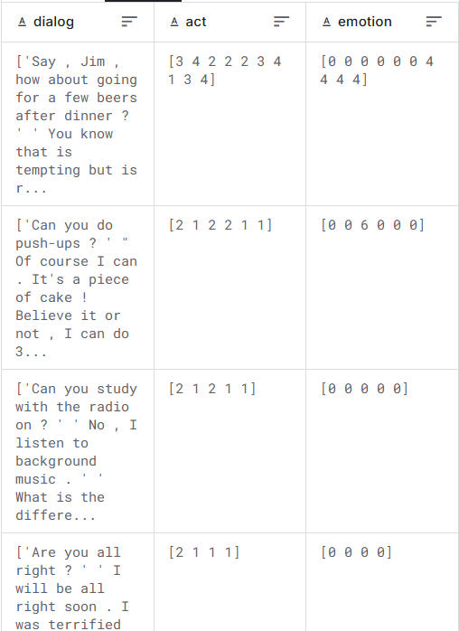
1. Dataset loading
Description:
Source: Hugging Face – DailyDialog
High-quality multi-turn dialogues
Covers daily conversation
Contains ~13k conversations
Data stats (number of conversations, avg. turns, etc.)

Slide 5
2. MODEL INITIALIZATION
Loaded pre-trained DialoGPT-Medium model
Initialized GPT2Tokenizer and GPT2LMHeadModel
Model is fine-tuned for dialogue generation tasks
Libraries:
Transformers by Hugging Face
GPT2Tokenizer
GPT2LMHeadModel

Slide 6
3. DATASET ENCODING
Tokenized each concatenated conversation using the tokenizer
Created input IDs for the model input
Generated labels for training with padding tokens ignored (-100 for ignored positions)
Applied truncation and padding to ensure uniform sizes

Slide 7
4. Training setup & fine-tuning
Training Configuration:
Batch size – 4 or 8 based on memory
Epochs – 3 to 5
Optimizer & Scheduler – default from trainer
Evaluation Strategy - per epoch
Process:
Defined TrainingArguments (output directory, learning rate, warmup steps)
Used Trainer API to fine-tune the model on the dataset.
Model learned to predict the next utterance in a dialogue context.

Slide 8
5. Monitoring training loss
This ensures that the model is learning effectively.
Helps detect overfitting or underfitting during training.
Tracked loss at regular intervals using the Trainer’s logging feature.
Observed a gradual decrease in loss over epochs.

Slide 9
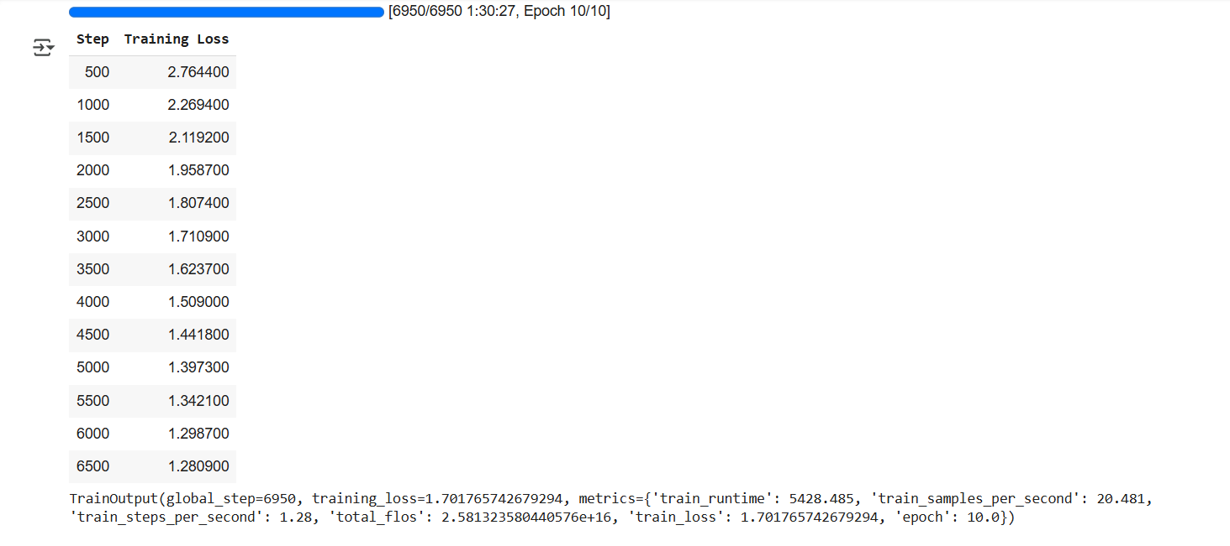

Slide 10
6. GENERATING SUMMARIES
Used the fine-tuned DialoGPT model to generate summaries for input dialogues.
Summaries are saved in a .csv file for evaluation and analysis.
Beam search or top-k sampling is used for better generation quality

Slide 11
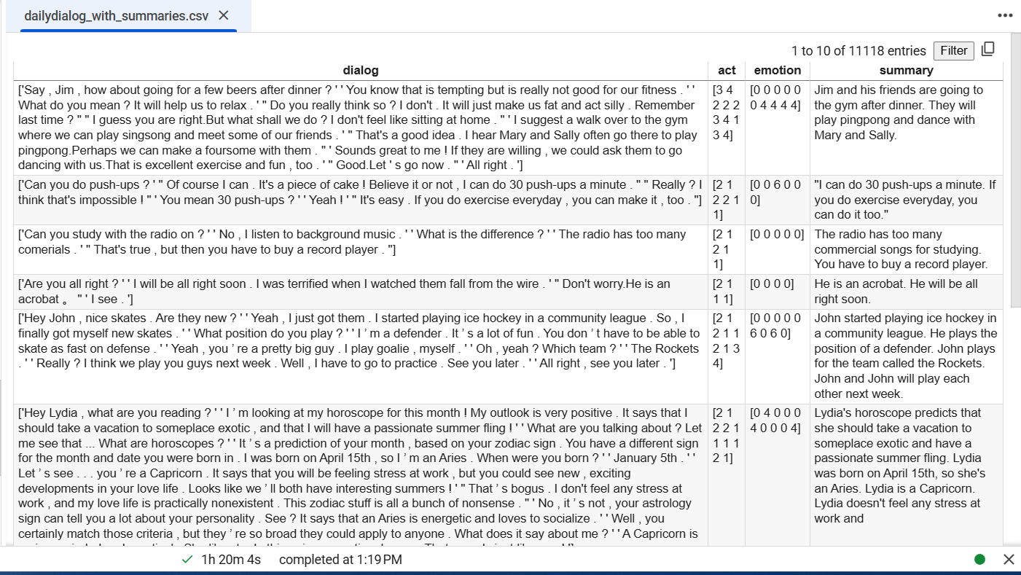

Slide 12
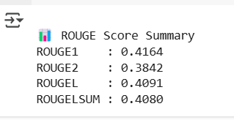
7. EVALUATION WITH ROGUE SCORES
Evaluation Metrics Used:
ROGUE-1: Overlap of unigrams (words)
ROGUE-2: Overlap of bigrams(word pairs)
ROGUE-L: Longest common subsequence
ROGUE-LSUM: Summary-level LCS score (variant)

Slide 13
Chatbot Deployment
We deployed our fine-tuned DialoGPT-Medium model as a chatbot.
Users can interact with the bot, which generates contextually relevant, human-like responses.
This demonstrates the practical application of our dialogue summarization and generation pipeline.

Slide 14
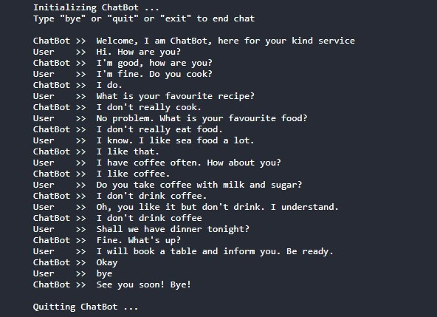

Slide 15
Conclusion
Successfully fine-tuned DialoGPT-Medium on the DailyDialog dataset.
Generated meaningful summaries from multi-turn dialogues.
Achieved decent ROGUE scores, validating the quality of generated summaries.
Successfully deployed chatbot using the summarization function that we created.

Slide 16
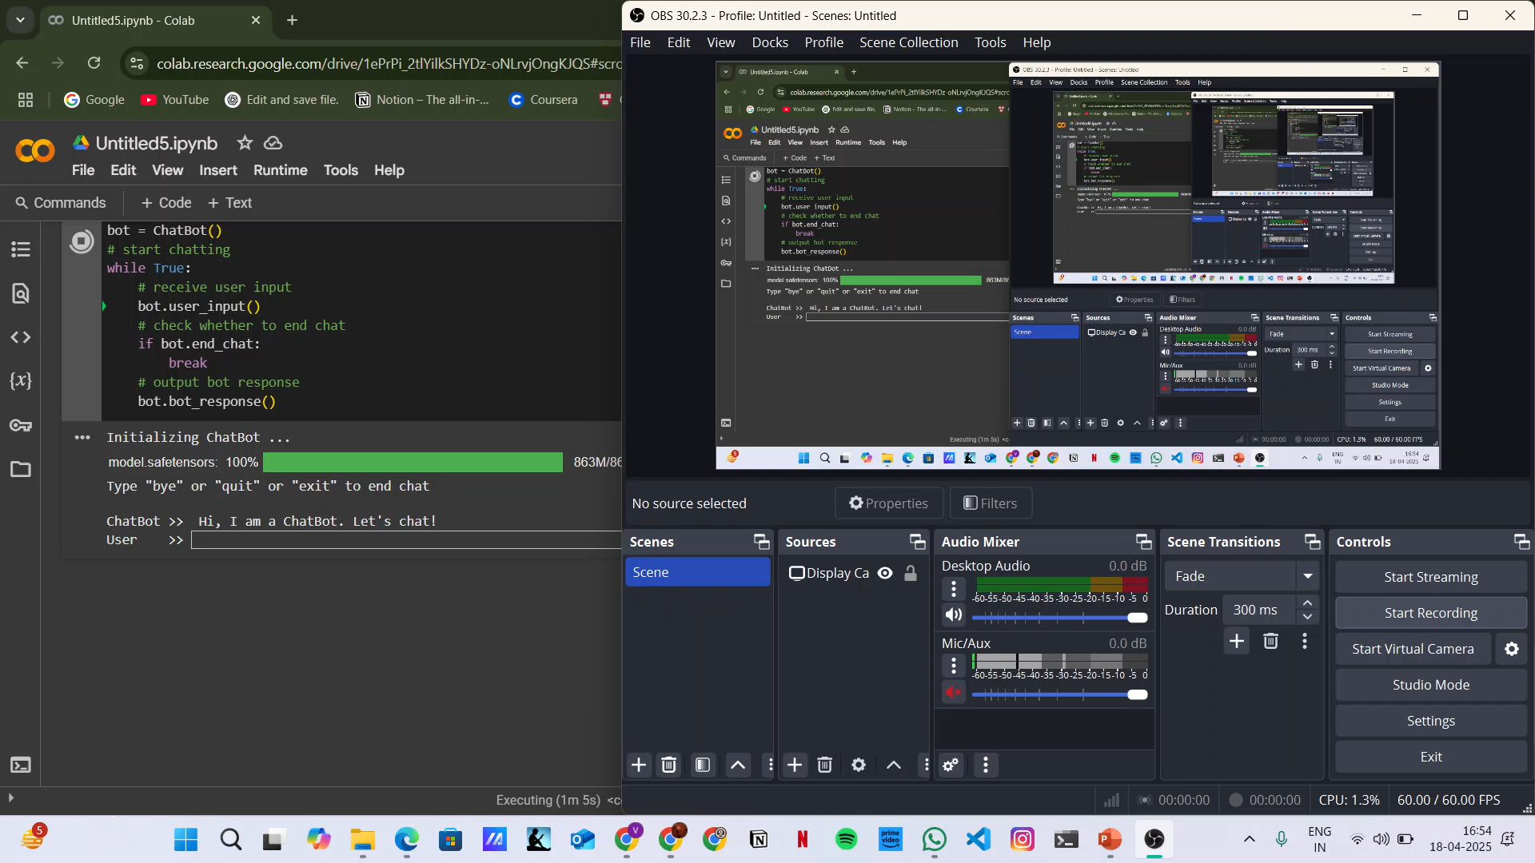
DEMO

Slide 17
THANK YOU

